Slide 1
ISC INTEGRATION UPDATE
PRESENTER NAME

Slide 2
AGENDA
Overview of project and recap of reasons for change
Where we are at in the timeline
What stays the same
What happens on May 1
Ongoing enhancements
We need your help
Notes:
Kimberly

Slide 3
FUTURE STATE VISION
Develop a more integrated, efficient, and employee-focused service model that will be able to more easily realize the process improvements and efficiencies in how we use Workday to support HR and payroll functions.
Notes:
Jessica

Slide 4
OVERVIEW
MOVING THE BUSINESS BACK TO THE BUSINESS
UW-IT remains responsible for enterprise system support
UWHR becomes responsible for supporting Workday end users for HR transactions in close partnership with OAP for academic personnel
FPB becomes responsible for supporting Workday end users for payroll transactions
Notes:
Jessica

Slide 5
OVERVIEW
TRANSITION TO WORKDAY FINANCE
Intricacies of Workday Finance require a specialized level of expertise, particularly in the realm of transacting within the system.
Moving Payroll back to Finance Planning & Budget will ensure Payroll staff have the resources and support they need to navigate and optimize payroll within the Workday Finance system.
Notes:
Jessica

Slide 6
DECISION REVIEW: Staffing
stays in UW-IT
App & Tenant Mngmt
Reporting
Shifts to UWHR
EWS (Tier 1) team
Shifts to FPB
Payroll team
Dedicated Tier 1 (2 fte)
HCM team
Dedicated HCM (1 fte)
Dedicated training & comms (2 fte)
Campus Engagement (4 FTE)
Notes:
KIMBERLY & JESSICA

Slide 7
DECISION REVIEW: Asset impacts
Name
Sunset ISC name
Website
ISC website rebranded and managed by UWHR on behalf of business owner
Support resources
CoP
Weekly Digest
Admin corner
Notes:
KIMBERLY

Slide 8
INTEGRATION TIMELINE
APRIL Focus on change management
MID JAN/FEB
Decision socialization and discovery
MARCH
Imagining the future state
MAY/JUNE May 1 transition followed by stabilization
JULY & BEYOND Process improvement
Notes:
HEATHER

Slide 9
WHAT STAYS THE SAME
Notes:
ERIN

Slide 10
WHAT WILL BE THE SAME?
EFFECTIVE MAY 1
You’ll work with the same people as today
You’ll be able to call during the same hours as today
You’ll see the same website content, and have the same website structure as on the ISC site today
You’ll use the same Contact Us and other ServiceNow forms that route to payroll (overpayment, retro) as you use today
You’ll be able to use the same Live Chat you use today
Notes:
ERIN

Slide 11
WHAT ELSE WILL BE THE SAME?
EFFECTIVE MAY 1
You’ll receive the same Admin’s Corner and Weekly Digest emails you receive today
This Community of Practice meeting will remain on your calendars
And the HCM / Tier 2 team will partner closely with OAP, as they do today as the Academic Personnel business owner
Notes:
ERIN AND HEATHER

Slide 12
WHAT IS CHANGING ON MAY 1
Notes:
COURTNEY: In addition to teams moving into different reporting structures, there will be more visible changes to our campus community.

Slide 13

WEBSITE NAME CHANGE
Notes:
COURTNEY

Slide 14
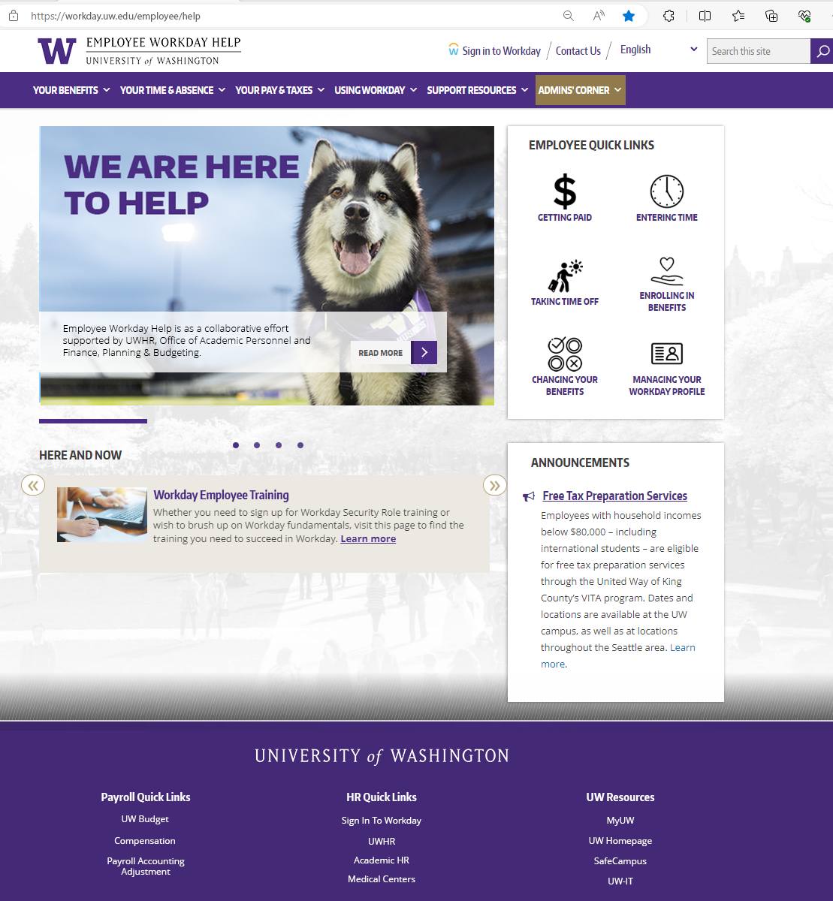
Notes:
COURTNEY

Slide 15
Notes:
COURTNEY

Slide 16
NEW FRONT DOOR
STRUCTURAL CHANGES
The EWS / Tier 1 team will split their work, to be closer to the UWHR business than they are today
Employment Verification and PSLF requests will be answered within UWHR, which they’re not today
Workday-related new employee onboarding support will be provided by UWHR
You’ll reach out for support at different email addresses than you do today
Notes:
MARISA

Slide 17
GETTING Qs TO THE BUSINESS UNIT
SERVICE OPTIONS IN ADDITION TO CONTACT FORM AND LIVE CHAT
payroll@uw.edu
benefits@uw.edu
hrhelp@uw.edu
UWHR will support call back and wait on the line options for people that call the help desks for support
Notes:
MARISA
Resources are situated directly into the business units to support providing
Specialization of knowledge within resources​
Timely resolution of questions and response time reduction​
Connecting the business with the transaction
Strives to minimize touchpoints while ensuring the customer reaches a satisfactory resolution efficiently.

Slide 18
ONGOING ENHANCEMENTS
AS WE PROGRESS THROUGH STABILIZATION
Quicker resolution to questions that span policy and process
Training remediation that blends policy and process to provide a more holistic learning experience
Process improvement effort that reduce redundancies
Notes:
MARISA

Slide 19
WE NEED YOUR HELP
COMMUNICATIONS
Help employees understand change
  Alert banners on UWHR and ISC website
  UW Insider posts
  Communication to cascade to your organization
Update ISC references in your department resources
When you find outdated ISC references embedded in Workday, a notification or website, please let us know at hrhelp@uw.edu
Notes:
MARISA

Slide 20
QUESTIONS?

