Slide 1
Update on temporary employment rules
Marisa Graudins
UW Human Resources

Slide 2
History
April 2018 – HB 2669 removes “part-time” from state civil service exemptions. OFM State HR submits minor changes to civil service rules defining “temporary”
August 2018 – Rules limit temp hours to 1,500 with 6-month break
August 2019 – Rules limit temp hours to 1,050 with 6-month break
November 2019 – Rules limit temps to 1,050 in a single 12-month period without reappointment. New appointment type called nonpermanent introduced.
March 2020 – State HR approves UW request to delay implementation of these rules due to COVID-19. Effective date of rules changed from July 1, 2020 to Jan 1, 2021.
October 2020 – Rules effective date delayed to January 1, 2022
Notes:
Fonts: https://www.washington.edu/brand/graphic-elements/font-download/

Slide 3
Proposed rule changes - Nonpermanent
Institutions of higher education may offer nonpermanent appointments:
Appointments of 12 – 24 months in duration that may be used to backfill leaves of absence, do project work, or handle short-term workload peaks
Nonpermanent appointments that are sporadic or ongoing in nature have no time limit
Nonpermanent appointments are covered by only a few sections of civil service rules:
Holidays & Leave (WAC 357-31)
Compensation (WAC 357-28)
Notes:
Fonts: https://www.washington.edu/brand/graphic-elements/font-download/

Slide 4
Proposed rule changes - Temporary
OFM State HR’s changes for temporary appointments:
Limit of 1,050 hours in a single, lifetime 12-month period
No ability to reappoint to a subsequent temporary appointment
Removes ability to ask OFM for jobs to exceed hours or period limits (e.g., per diem RNs).
The 12-month period begins from the original date of hire or January 1, 2022 (whichever is later).
Notes:
Fonts: https://www.washington.edu/brand/graphic-elements/font-download/

Slide 5
Major impacts
Temporary (as defined currently) | New | Schedule | FTE | Pay Rate Type | End Date
A temp regularly working 10 hours per week | Regular classified 0.25 FTE with no end date | Regularly scheduled | Yes | Salary | None
An hourly temp working intermittently on an ongoing basis (e.g., per diem nurse) | Nonpermanent classified hourly paid employee with no end date | Intermittent/ Ad Hoc | No | Hourly | None
A temp regularly working 40 hours per week for 4 months | Nonpermanent classified 1.0 FTE with end date | Regularly scheduled | Yes | Salary | Yes
A temp intermittently working as needed for 4 months | Non classified hourly paid employee with end date | Intermittent/ Ad Hoc | No | Hourly | Yes
Notes:
Fonts: https://www.washington.edu/brand/graphic-elements/font-download/

Slide 6
What we know
Rule changes occur on January 1, 2022, resulting in the “effect” on temporary employment occurring 12 months later, January 1, 2023.
The Washington State Public Employment Relations Commission (PERC) is also engaging in rule-making as a result of State HR’s rule-making. This impacts “350 rule” for inclusion in the bargaining unit.
UW understands how general government uses nonpermanent employment and is actively partnering with State HR to implement the change and support ongoing rule-making.
Notes:
Fonts: https://www.washington.edu/brand/graphic-elements/font-download/

Slide 7
Questions?
Email Marisa Graudins: marihoug@uw.edu

Slide 8
FLSA & WMWA (L&I) Update
Randy West
UW Human Resources

Slide 9
Overtime eligibility
Driven by two laws:
Fair Labor Standards Act (FLSA)
Washington Minimum Wage Act (WMWA)
duties
salary threshold
Notes:
Fonts: https://www.washington.edu/brand/graphic-elements/font-download/

Slide 10
2021 and beyond: Salary threshold
On January 1, 2021, the WA state overtime salary threshold will exceed the federal threshold under the FLSA.
Since the higher state salary threshold for overtime exemption under the WMWA will be more generous than the FLSA, the WMWA threshold will be applied.
Notes:
Fonts: https://www.washington.edu/brand/graphic-elements/font-download/

Slide 11
Changes coming in 2021 and beyond
1/1/21 the WMWA threshold will increase to $958.30 (UW uses $958.38 due to rounding), which exceeds the FLSA threshold of $684 per week.
WMWA threshold will go up two ways:
To higher multiples of WA State minimum wage, reaching 2.5x by January 1, 2028
Following inflation, since WA State minimum wage is indexed to inflation (CPI-W).
Note: FLSA threshold is a static number. WMWA is now a dynamic number, changing annually.
Notes:
Fonts: https://www.washington.edu/brand/graphic-elements/font-download/

Slide 12
Notes:
Fonts: https://www.washington.edu/brand/graphic-elements/font-download/

Slide 13
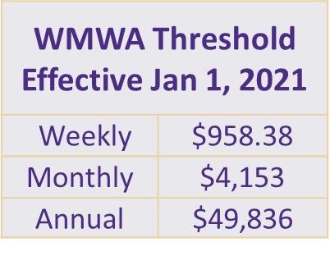
Impact on Part-Time Employees
The threshold is applied equally to full-time and part-time employees, so part-time employees are less likely to meet the threshold.
Note: the values in this table are slightly higher than those announced by L&I,
due to rounding for monthly rates in UW payroll system.
Notes:
Fonts: https://www.washington.edu/brand/graphic-elements/font-download/

Slide 14
Example: Employee earning $90K/year
Is the employee OT exempt? Maybe. It depends on their FTE.
.
Note: Full-time equivalent rate needed for 50% FTE to be OT exempt: $99,673
Notes:
Fonts: https://www.washington.edu/brand/graphic-elements/font-download/

Slide 15
Impact
Dept may choose to let employees become OT eligible or change FTE and/or salary to maintain OT exempt status
Responses so far:
55% choosing to allow change to OT/straight time eligible
45% choosing FTE and/or pay increase
Notes:
Fonts: https://www.washington.edu/brand/graphic-elements/font-download/

Slide 16
How to choose: Become OT eligible?
Track all hours worked Paid 1.5x for >40 hours in a workweek
Cost impact mitigated by not exceeding 40 hours in a workweek
May result in loss of productivity if employee regularly works more than 40 hours
Good solution for those generally working their FTE and/or already earning contractual overtime for hours over schedule or community practice
May impact work schedules
Notes:
Fonts: https://www.washington.edu/brand/graphic-elements/font-download/

Slide 17
How to choose: Remain OT exempt
Depts may choose for an employee to remain OT exempt by changing their FTE or salary
Good solution for those who regularly exceed their FTE and whose work does not neatly fit into a standard 40 hour Mon – Sun workweek.
May compress salaries, necessitating a review of salaries for similarly situated employees and/or their managers.
Pay equity policy
Contact the Compensation Office
Campus: uwhrcomp@uw.edu
Medical Centers: medcomp@uw.edu
Notes:
Fonts: https://www.washington.edu/brand/graphic-elements/font-download/

Slide 18
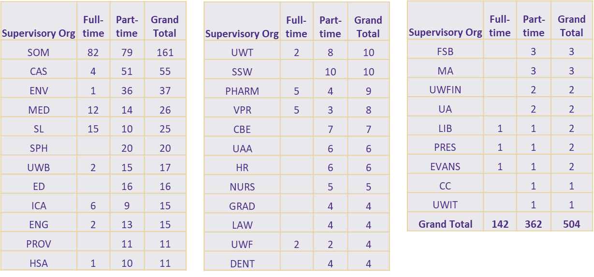
Impact by Supervisory Org (as of PPE 9/30)
Notes:
Fonts: https://www.washington.edu/brand/graphic-elements/font-download/

Slide 19
What happens to an employee who becomes OT eligible?
Q: WHAT STAFF EMPLOYEES WILL BE AFFECTED BY THE CHANGES?
A: Salaried classified and professional staff employees who are currently OT exempt but whose actual pay is less than $958.38 per week will be moved into OT eligible job codes and must track their time starting Monday, December 28, 2020.
Notes:
Fonts: https://www.washington.edu/brand/graphic-elements/font-download/

Slide 20
What happens to an employee who becomes OT eligible?
Q: WILL A PART-TIME EMPLOYEE WHO BECOMES OT ELIGIBLE RECEIVE OT?
A: Part-time employees who become OT eligible will only receive overtime (at time-and-a-half) if they work over 40 hours in a workweek. However, they will receive straight time pay for all hours worked beyond their FTE hours and up to 40 in a workweek.
Notes:
Fonts: https://www.washington.edu/brand/graphic-elements/font-download/

Slide 21
What happens to an employee who becomes OT eligible and is part-time?
Example: Employee at 50% FTE (20 hrs/wk) becomes overtime eligible.
Employee is scheduled to work 20 hrs/wk but in a specific workweek actually works 25 hours
Result: employee is paid for 25 hrs, 5 more than the 20 hours scheduled for 50% FTE.
The 5 hour overage is paid at “straight time” overtime, i.e., the same rate as their normal salary, not time-and-a-half.
The employee is only paid overtime at time-and-a-half for hours over 40 in a workweek.
Notes:
Fonts: https://www.washington.edu/brand/graphic-elements/font-download/

Slide 22
Key Dates
9/21/20: HR Admin Council email # 1 with list of affected employees
9/30/20: L&I announced 1/1/21 min wage and revised OT threshold
10/30/20: HR Admin Council email # 2 with updated list of affected employees; publish L&I threshold guidance and FAQs on HR Comp website
11/30/20: HR Admin Council email # 3 with final list of affected employees
12/2/20: Depts. should notify ees who are changing by this date
12/7/20: HR Comp sends final list of changing ees to ISC for upload
12/27/20: ISC uploads job code changes to OT eligible codes
12/28/20: Time tracking for newly OT eligible codes begins
Notes:
Fonts: https://www.washington.edu/brand/graphic-elements/font-download/

Slide 23
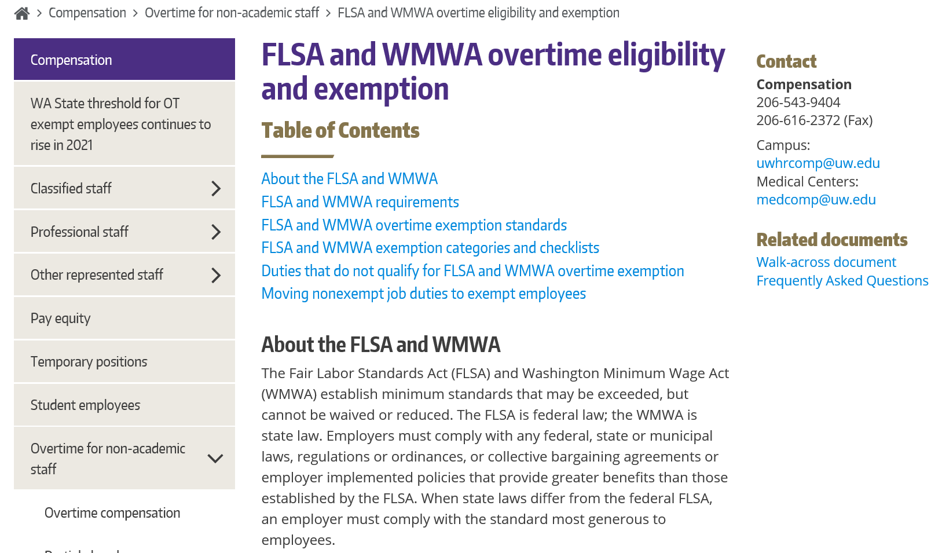
Updates to HR Compensation Website
Notes:
Fonts: https://www.washington.edu/brand/graphic-elements/font-download/

Slide 24
Questions?
Email Randy West: rfwest@uw.edu

Slide 25
Open Enrollment 2020
Barry Nemeth
UWHR Benefits, Analytics, and Information Systems

Slide 26
PEBB Open Enrollment
Open Enrollment is November 1-30
Changes are effective January 1, 2021
Changes can be made to:
Medical Plan
Dental Plan
Add previously uncovered dependents
Medical Flexible Spending Account (FSA)
Dependent Care Assistance Program (DCAP)

Slide 27
New Medical Plan – UMP Select
PEBB has added a new medical plan for 2021
UMP Select
Same network as UMP Classic
Premium: $37 employee only
Deductible: $750
OOP Max: $3,500

Slide 28
Medical FSA and DCAP
Medical FSA 2021 Annual Contribution Limits
Minimum - $240
Maximum - $2,750
DCAP Contribution Limits
$5,000 if single or married filing jointly
$2,500 if married filing separately

Slide 29
Health Savings Account (HSA)
2021 Contribution Rates
Subscriber only: $3,600
Subscriber + Dependents: $7,200
Age 55 Catch-up: $1,000
Only allowed for CDHP medical plans

Slide 30
Special Opportunity for Life Insurance
One-time opportunity to apply for or increase optional life insurance
Answer five health questions
Questions and election made directly with MetLife
https://mybenefits.metlife.com/wasebb

Slide 31
2021 Retirement Limits (UWRP/VIP)
Annual Compensation
Increases to $290,000
Annual Additions
Increases to $58,000
Employee Elective Contributions
Remains $19,500
Age 50 Catch-up
Remains $6,500

Slide 32
Open Enrollment Assistance
Contact the ISC for Open Enrollment assistance
Phone: 206-543-8000
Email: ischelp@uw.edu
Open Enrollment elections* are made in Workday
www.isc.uw.edu
*Life insurance elections made directly on MetLife’s webpage: https://mybenefits.metlife.com/wasebb

Slide 33
Questions?
Email: totalben@uw.edu

