Slide 1
Title IX Update
Erin Rice
UW Human Resources

Slide 2
New Regulations Effective August 14
The new federal rules apply to all students and employees
Institution must respond when notice/allegation of sexual harassment is received by the Title IX Coordinator OR any official who has authority to institute corrective measures on behalf of the institution
For UW staff, an official with authority is someone who has authority to terminate employment
These officials MUST inform SafeCampus if they receive an allegation of sexual harassment
Everyone else is, as always, strongly encouraged to contact SafeCampus if they become aware of sexual harassment

Slide 3
Definition of Sexual Harassment
New regulations have a higher standard of what constitutes sexual harassment:
quid pro quo
unwelcome conduct on the basis of sex that is so severe, pervasive, and objectively offensive that it effectively denies a person equal access
sexual assault, dating violence, domestic violence, and/or stalking as defined by VAWA/Clery
UW’s current definitions:
prohibit a broader range a conduct
are consistent with other federal and state laws (e.g. Title VII)
UW will continue to address conduct that does not meet the
new definition using current policies and procedures
Notes:
Fonts: https://www.washington.edu/brand/graphic-elements/font-download/

Slide 4
Investigations and Hearings
For allegations that meet the new definition, UCIRO will investigate
The Title IX office will conduct hearings for both students and employees
Oral cross-examination by advisors is required

Slide 5
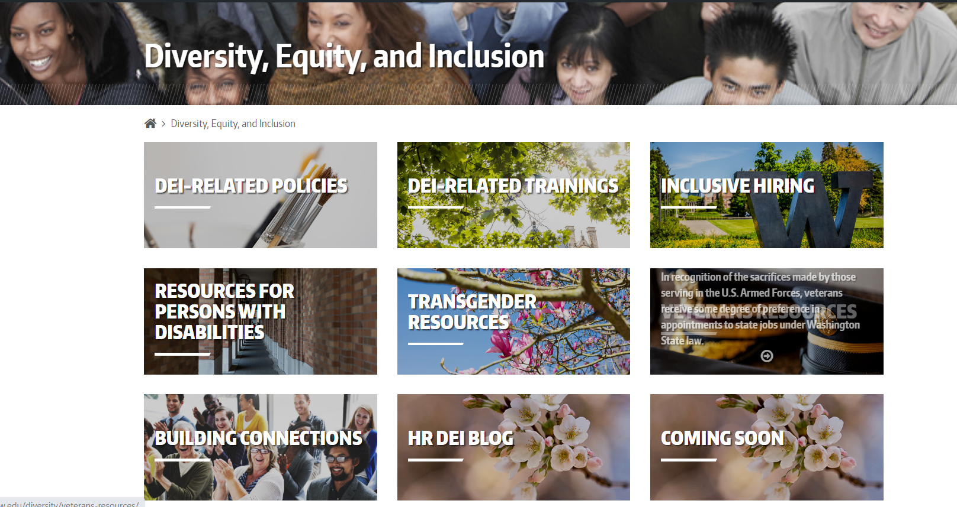

Slide 6
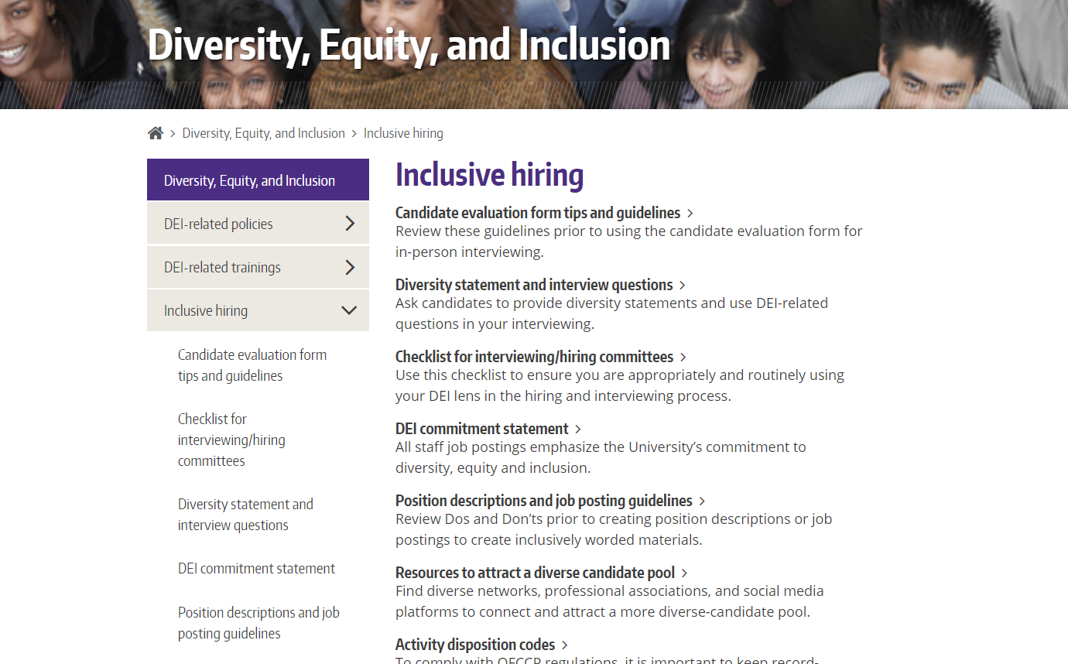
TEMPLATE FOR Q&A ONLY
Don’t use this gold background template please – for adding in Q&A from the event only.

Slide 7
THANK YOU!
The World is full of good.
In these times, that is an invaluable need to be reminded of.
Thank you all with all my heart.
-- UW COVID-19 Employee Emergency Fund recipient
Refer a colleague in need of support here. Donate to the fund here.

