Slide 1

Your Gift Makes a Difference
2025 UWCFD Campaign Coordinator Training

Slide 2
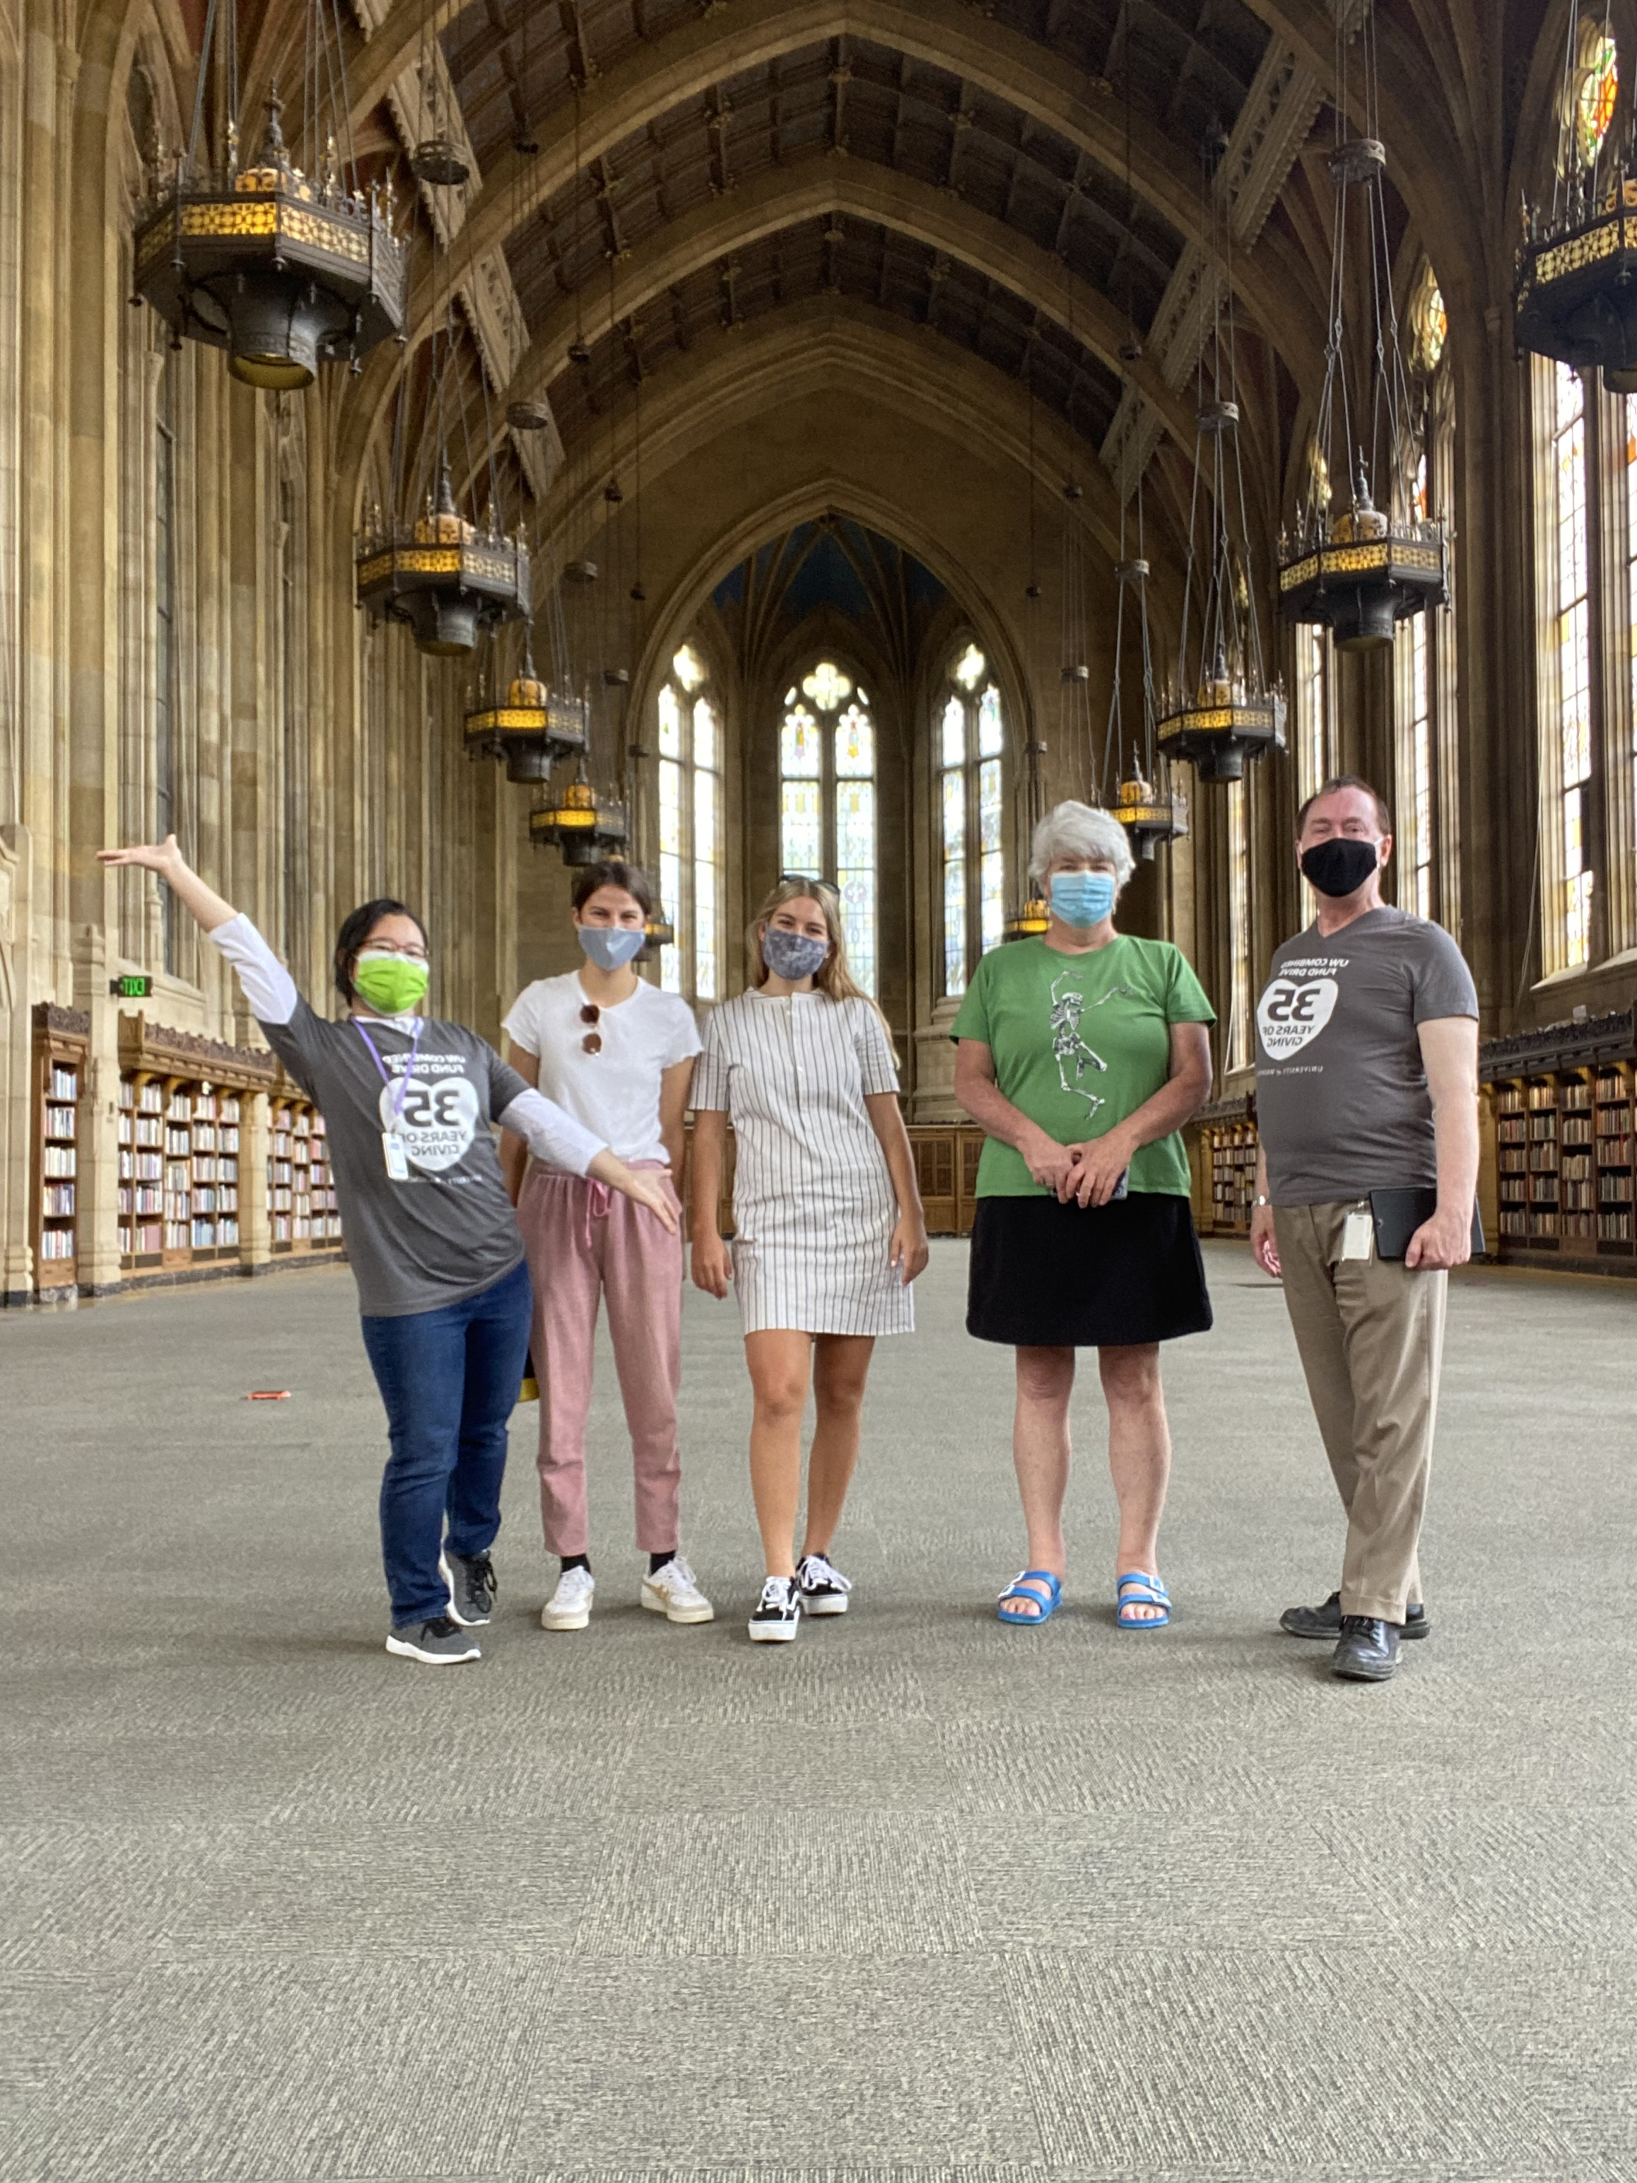
Thank you for being a campaign coordinator!
UWCFD campaign coordinators are the key to a successful campaign. This role is vital in maintaining robust nonprofit organizations and healthy communities.
2021 campaign assistants at the Suzzallo Library reading room during a campus tour

Slide 3
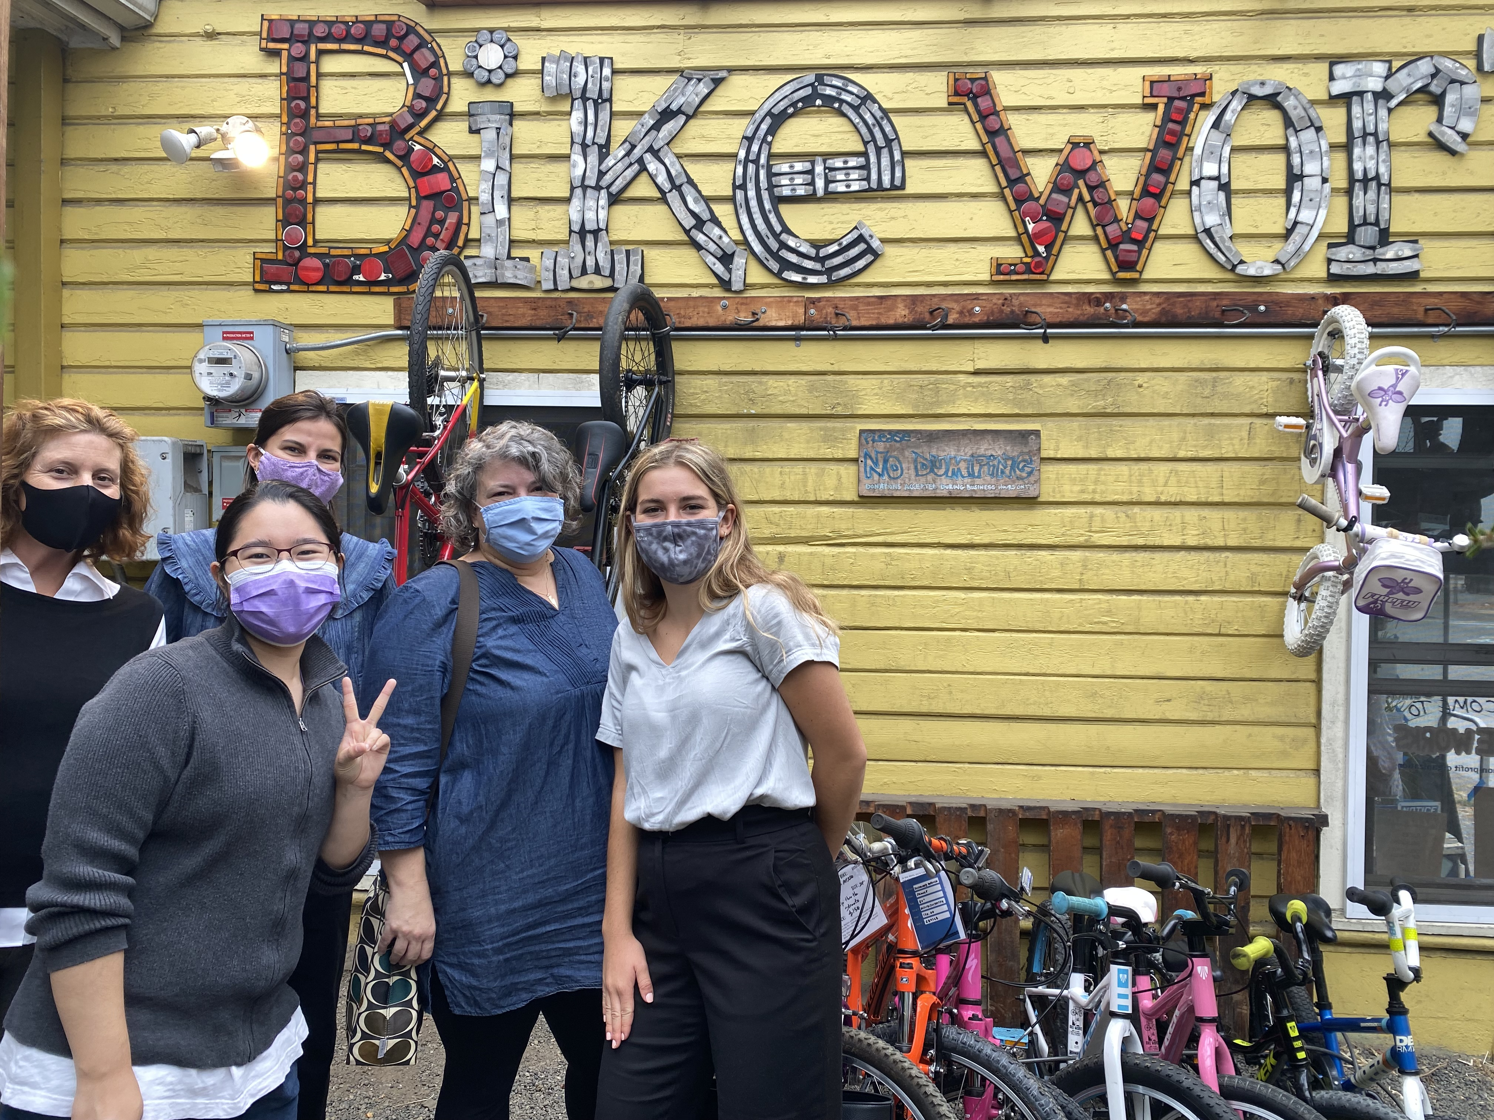
Contents
History and mission of the campaign
Meet the UWCFD team
Coordinator information
Important dates
What is simple giving?
UWCFD campaign assistants and staff tour Bikeworks, a Seattle-based nonprofit

Slide 4
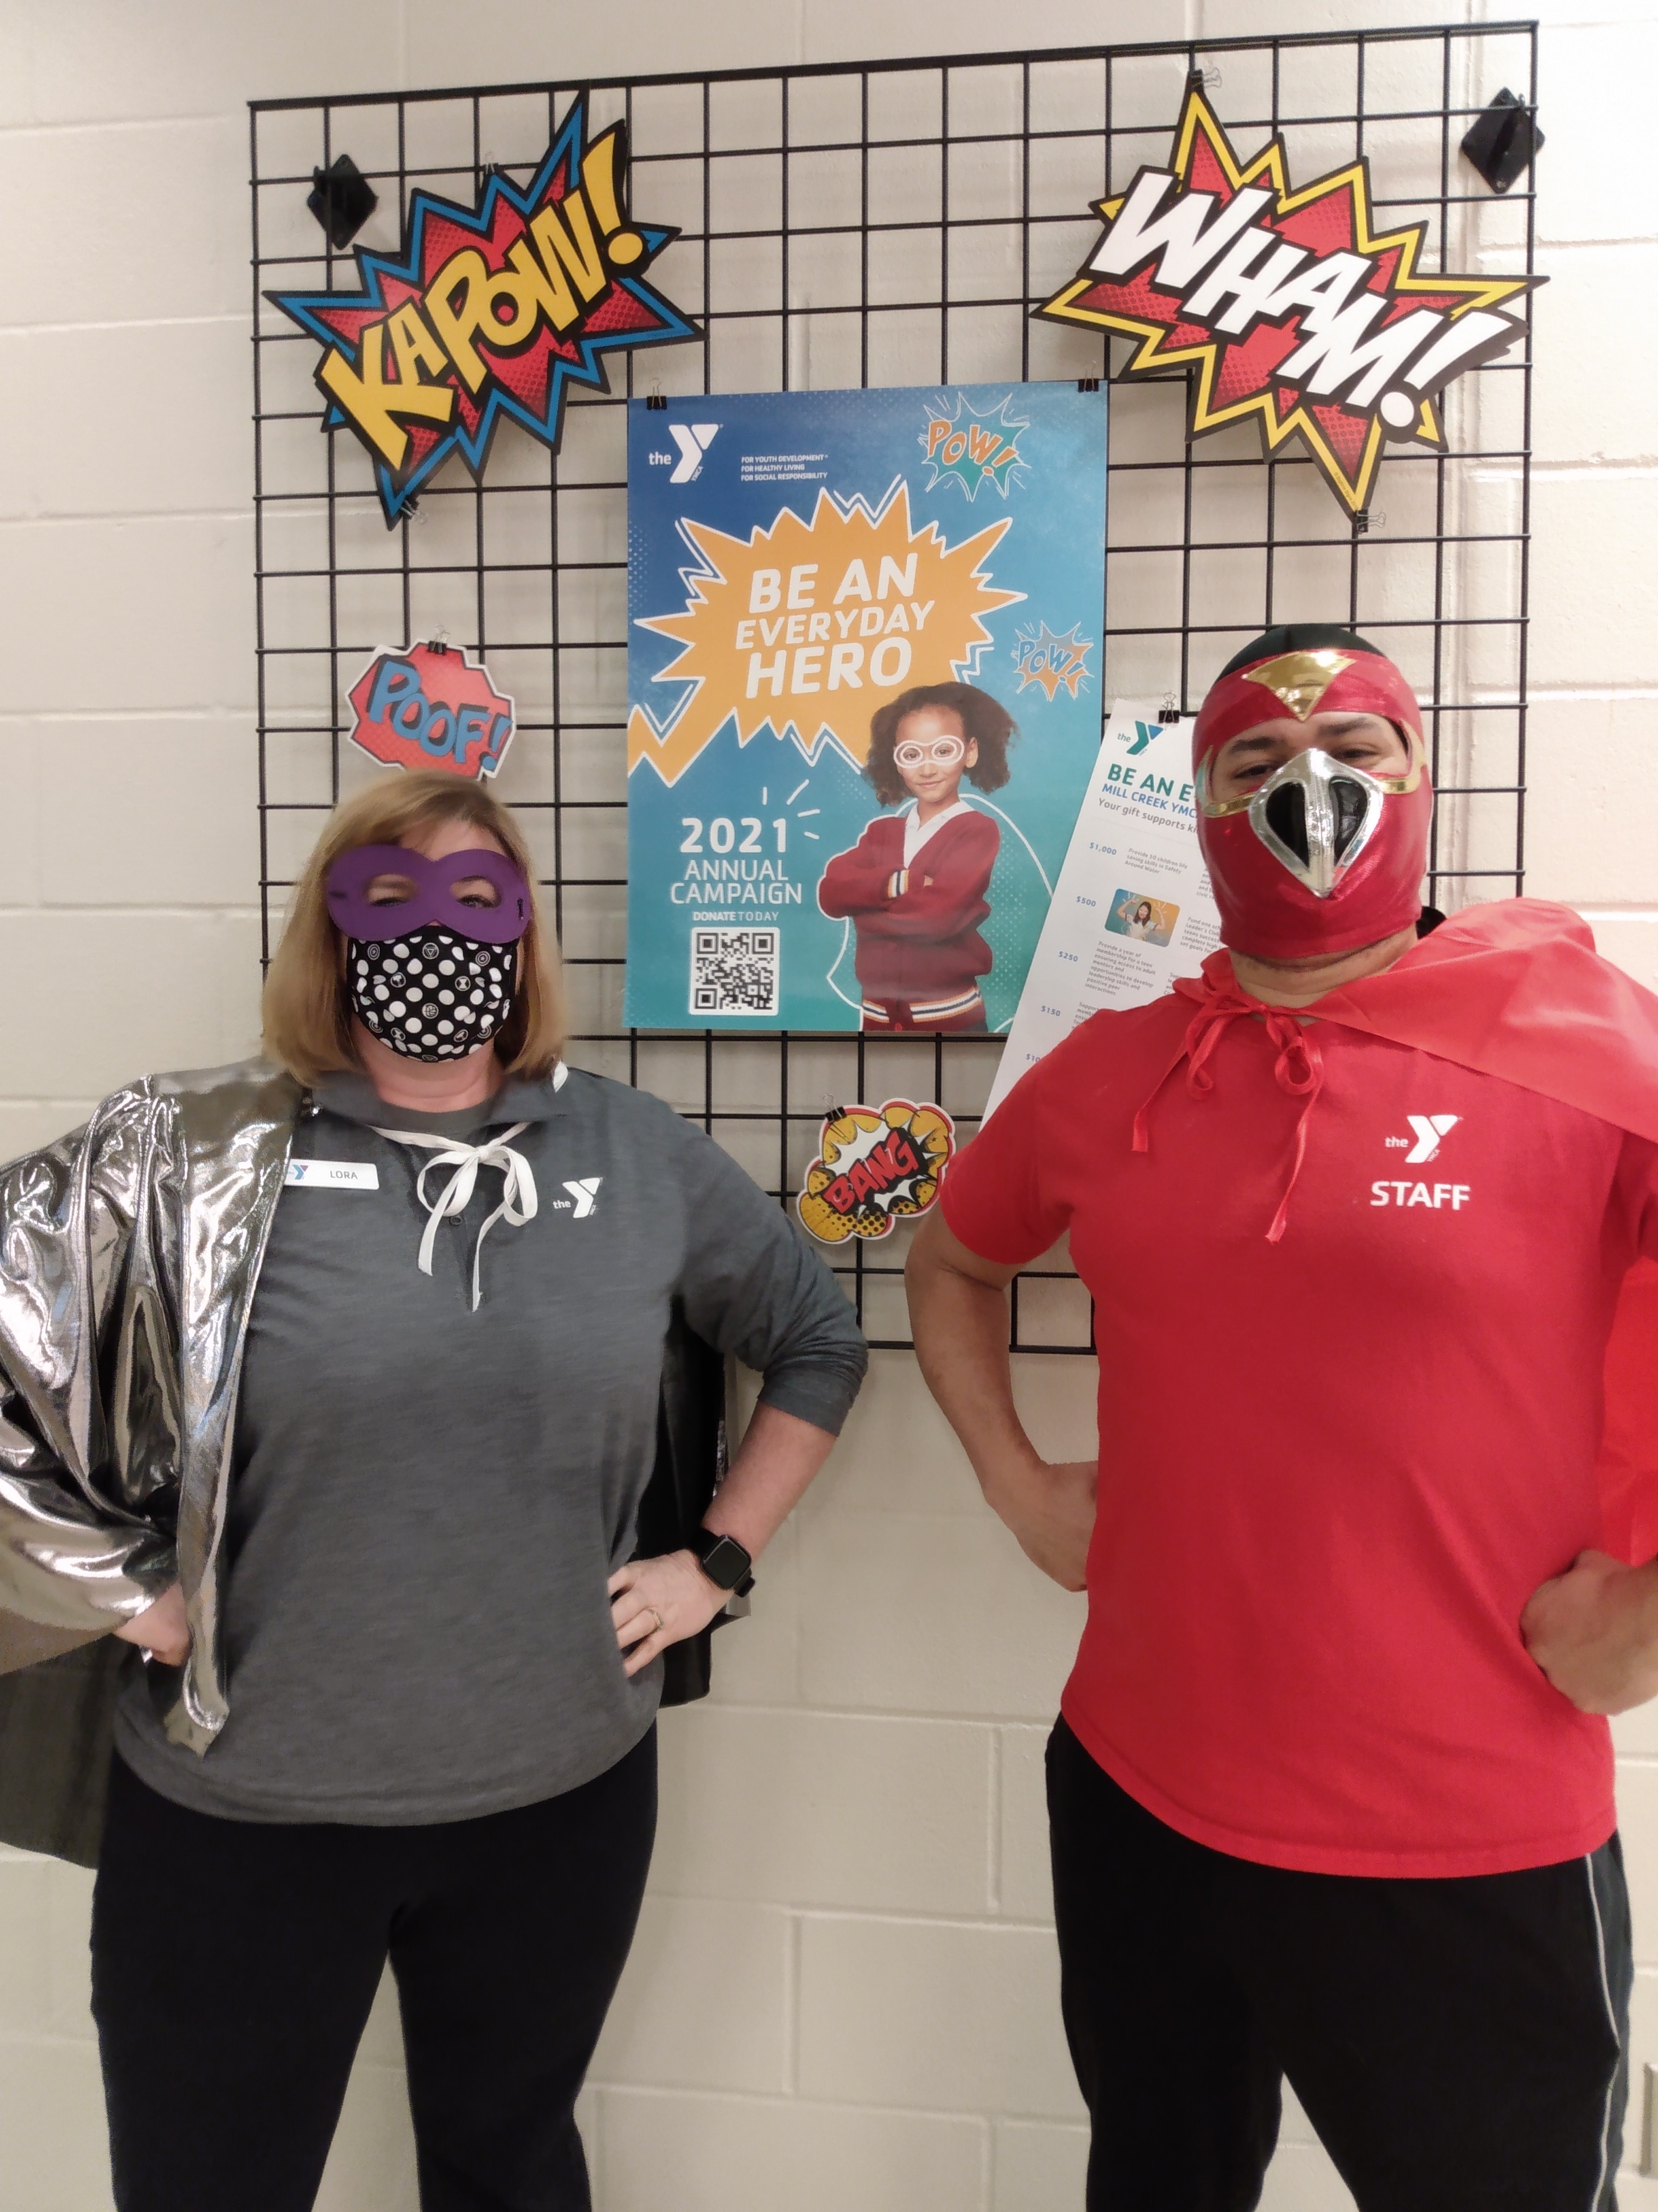
What is the Combined Fund Drive (CFD)?
The CFD is Washington state’s workplace giving campaign, providing employees and retirees the opportunity to make a significant impact in their communities and change people’s lives.
Snohomish County YMCAs held a “superhero” week during their 2021 annual campaign

Slide 5
Mission of the Campaign
Empowering Washington state public employees and retirees to strengthen communities through the funding and support of charities.

Slide 6
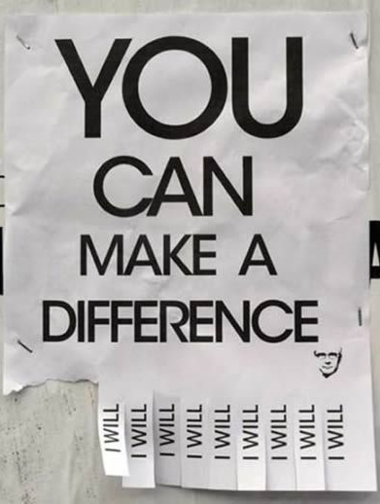
History of the Campaign
Since 1984, UW employees and retirees have raised more than $59 million

Slide 7
You’re the Campaign Coordinator!
What does that mean?
You will plan your campaign, share information with your colleagues, and let them know how easy it is to give.

Slide 8
Good News for Coordinators!
The UWCFD is an official part of state business. What does that mean? Volunteers (you!) are allowed to work on the campaign during business hours. Be sure to get your supervisor’s approval for your campaign plan.
For the data lovers in the crowd, you can review WAC 434-750-010 - 434-750-300 for specific rules surrounding the campaign.

Slide 9
2025 Campaign Theme
Your Gift Makes a Difference

Slide 10
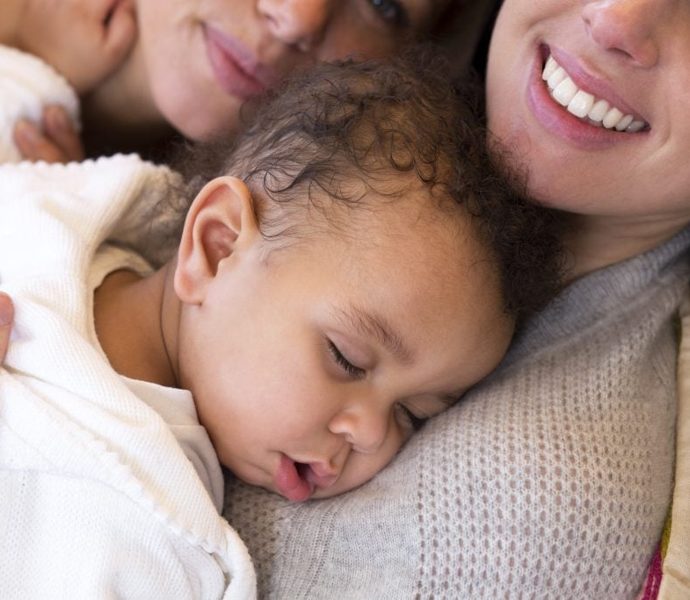
2025 Featured Nonprofit
WestSide Baby

Slide 11
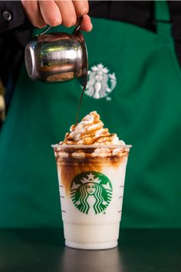
Campaign Dates:
October 14 – December 5, 2025
First week to give is October 14 -21
  New and returning donors can earn a $5 Starbucks card compliments of WSECU
    Make a pledge of $5 or more or add $5 or more to an existing donation
    Volunteer for a minimum of one hour for a UWCFD member charity and track the hours using the CFD Volunteer Tracker

Slide 12
Why CFD?
Benefits to employees
All your tax-deductible charitable giving is in one place, conveniently listed for you on your annual W-2
Make a bigger difference by making a larger overall gift in smaller increments
Make changes to your giving anytime, from any device
Respond immediately to developing situations or shifting priorities
All charities are vetted by the Office of the Secretary of State

Slide 13
Why CFD?
Benefits for nonprofits
Workplace giving provides a reliable source of revenue. Organizations get a quarterly disbursement so they can plan around those resources.
We are an open campaign and add new organizations year-round. If you can’t find your favorite organization, we can work with them to join the campaign!
Low administrative costs! Overall, the Combined Fund Drive is the most efficient way to raise large amounts of money at a very small cost and assures the maximum possible funding goes directly to charities.

Slide 14
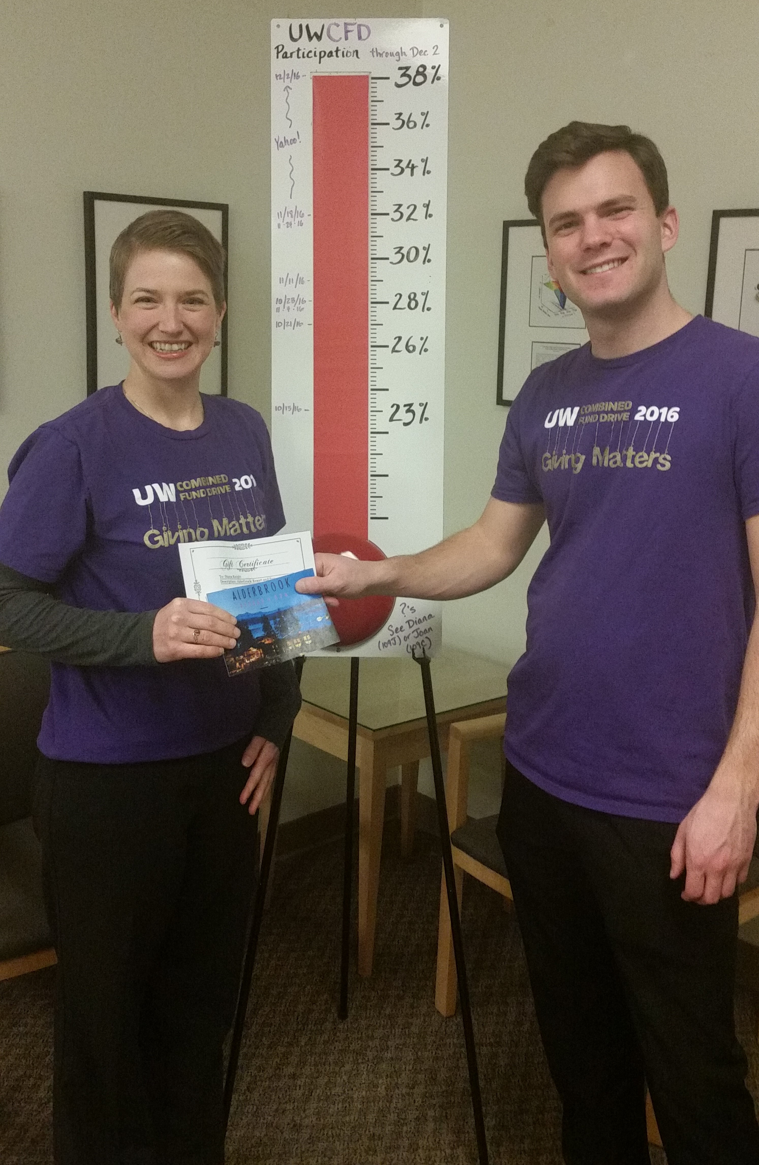
Coordinating a UWCFD campaign is fun and easy
The giving process is simple: most UWCFD donors give through payroll deduction, which can be set-up online in minutes.
  Donors can also write a check and send it through campus mail with a giving form
The impact of our collective giving is enormous! All our gifts together add up to a big difference for communities – locally, nationally and around the world.

Slide 15
Value of Workplace Giving
Customize your campaign to match the culture of your office – what do your colleagues want to see or read or do?
Lunch & learn with charitable organization reps
Volunteer and/or nonprofit spotlight in your newsletters
Social media challenges and contests
Donation drives – virtual or on-the-ground
You set the game plan and we’ll help you make it happen!

Slide 16

Value of Workplace Giving
Engage your co-workers and enhance common culture
Increase team connection
Create shared goals
Enhance workplace culture

Slide 17
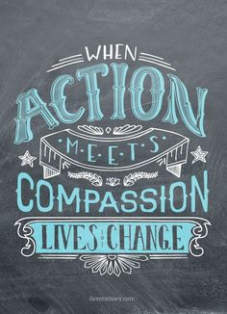
Volunteer!
Employees can also volunteer their time to support their favorite nonprofits. The gift of time has an average value of $41.70 per hour!
The Volunteer Tracker tool, located in the individual’s CFD account, can be used to track volunteer hours with CFD charities.

Slide 18
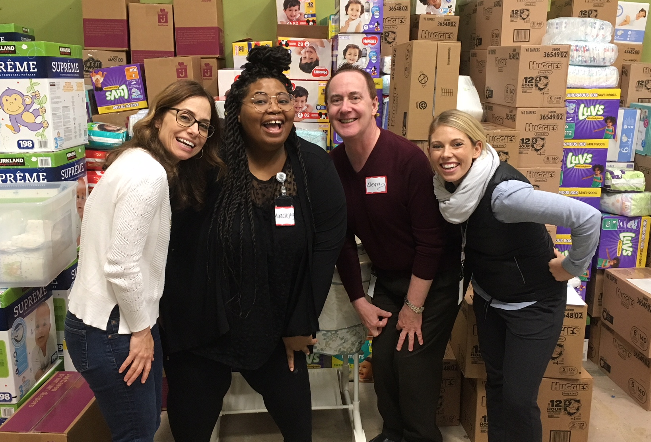
Resources for Coordinators: People
One of the great things about this campaign is all the structure in place - you’ve got a team to help you out:
Campaign Assistants and UWCFD staff
Your manager and co-workers
Past coordinators
2018 Campaign Assistants at a diaper drive for WestSide Baby

Slide 19
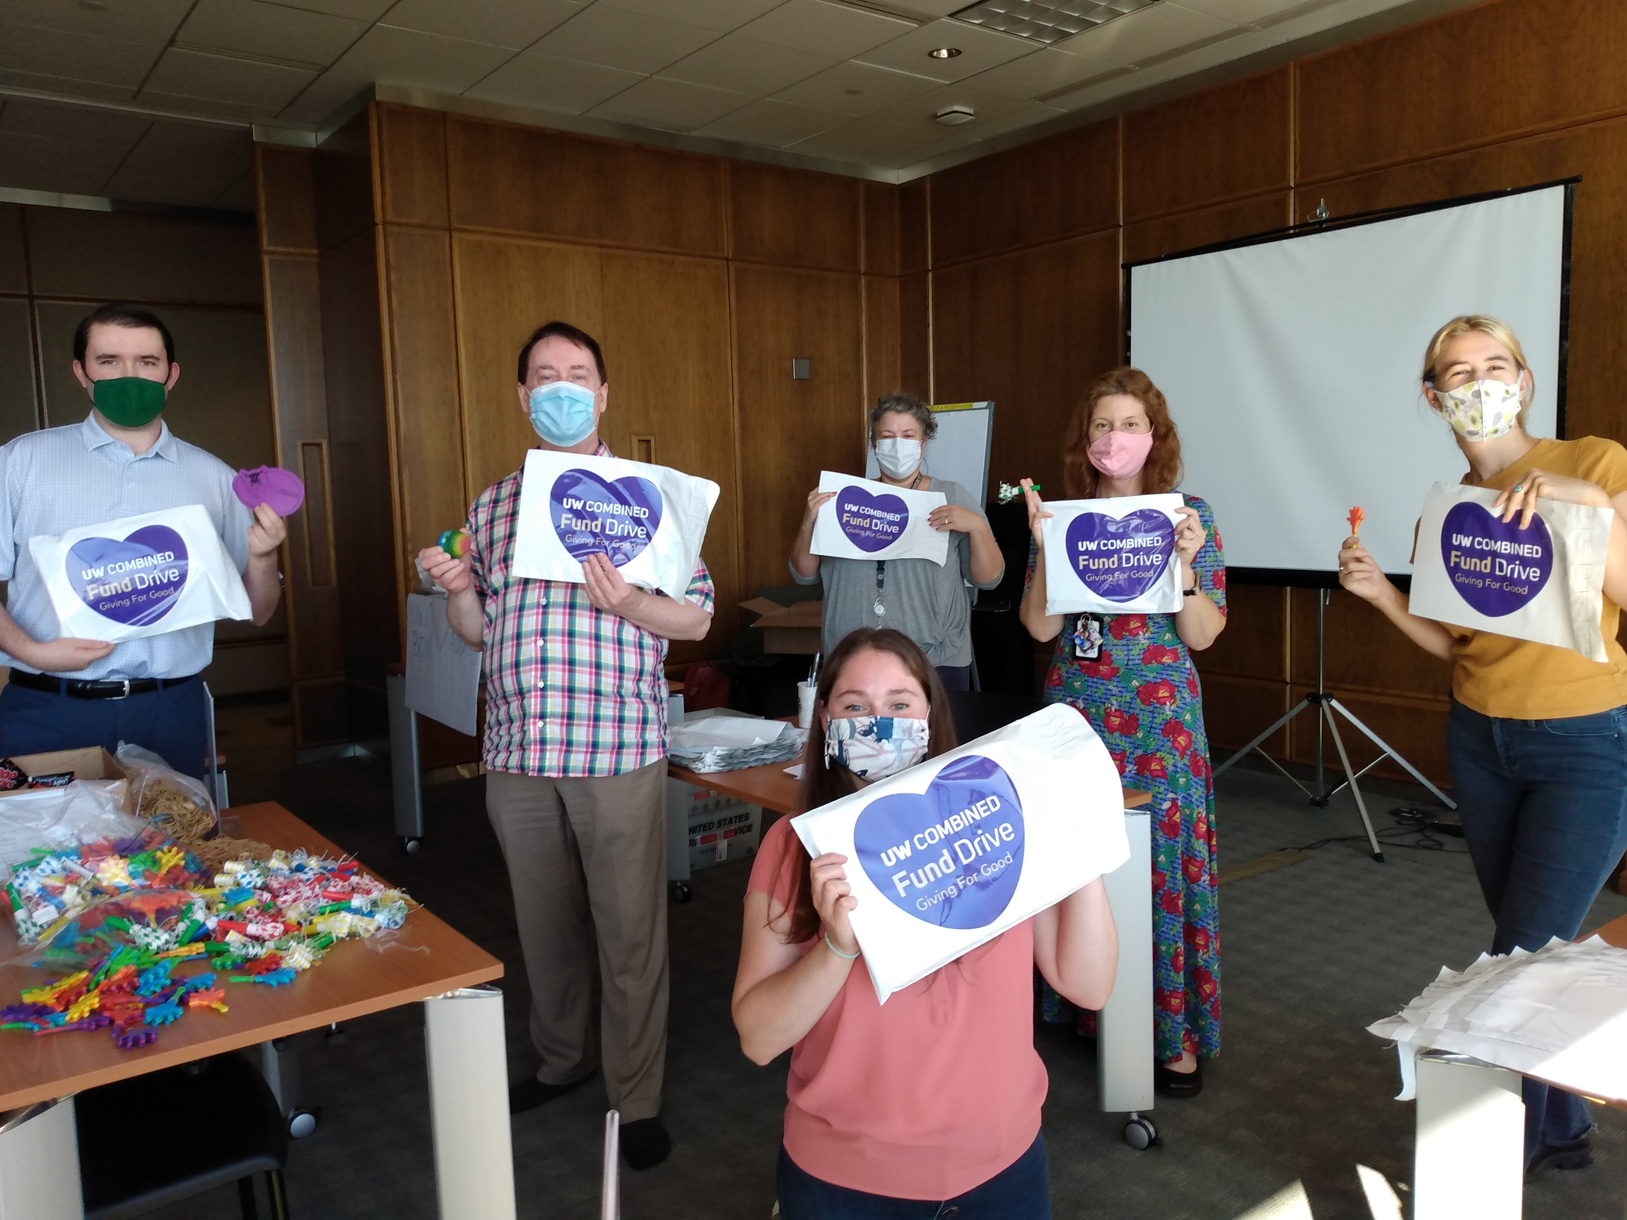
Resources for Coordinators: Toolkits
You have various resources available to you on the CFD website or through your campaign assistant:
Promotional materials
Fundraiser guidelines
Online promotions
Impact statements

Slide 20
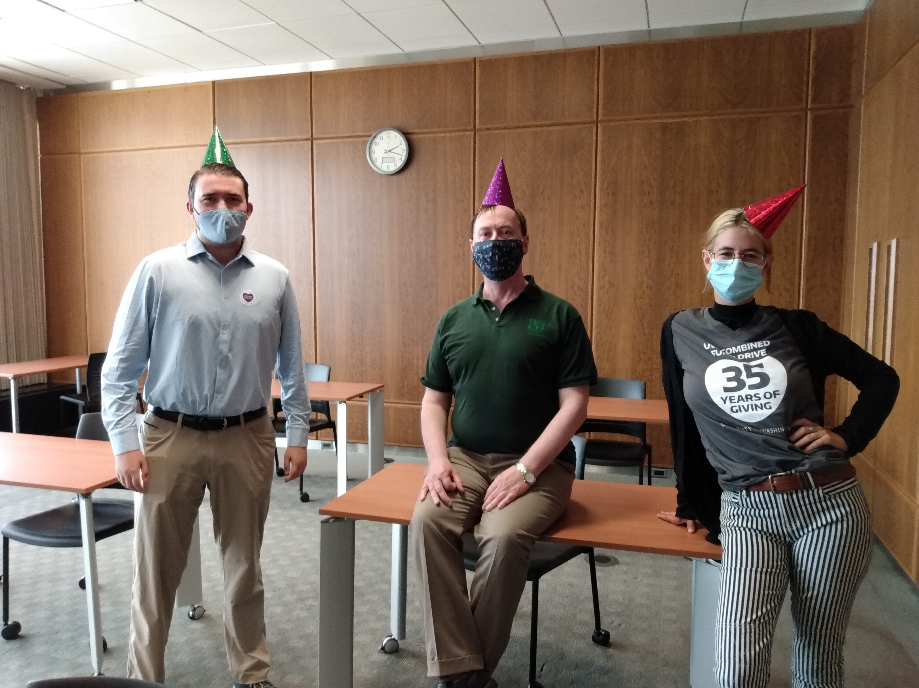
Join the UWCFD Events Committee!
The UWCFD Events Committee includes volunteers from across campus and representatives from local charities who work year-round on strategic planning, on events such as:
Annual nonprofit expo
Coordinator kickoff
Volunteer recognition

Slide 21
Campaign 2024 Events
First week to give coffee card promotion
Virtual nonprofit expo, Tuesday October 14
Lunch & learn seminars starting Oct 28
Virtual auction, October 14 – 21
Last week to give promotions and giveways

Slide 22
Have questions? Need more resources?
Reach out to your campaign assistant anytime you need assistance! You can also contact the UWCFD office at uwcfd@uw.edu or 206-616-3678.
THANK YOU!

